Slide 1
Assist Robot
Team 8
Priyadarsini Nidadavolu(17)
Deepti Priya Darshini Penmetsa(22)
TejKumar Yentrapragada(33)
Dheeraja vallabhaneni(28)

Slide 2
Features and Data Sets used
To find the misplaced things like keys, watch, phone etc.,
To build a recommendation system which should be able to recommend the Possible Locations of the articles.
To make a robot to serve multiple people within a house. (Face Recognition/User Login)
To send notifications to either user phone or smart watch about the object identified and also the possible location of the article that was misplaced.
The first dataset could be a set with list of images of the articles with which we need to train our robot.
The dataset which specifies the location of the articles that is preferred by the user will be our second dataset.
The dataset which specifies the list of users, whose commands needs to be taken.

Slide 3
Workflow
Yes
User
Interacts
Robot
Socket Streaming
Spark
Does
Image Classification
Sends Results
Data Sets
Object Identification
Location Recommendation
Found ??
No
Keeps Searching

Slide 4
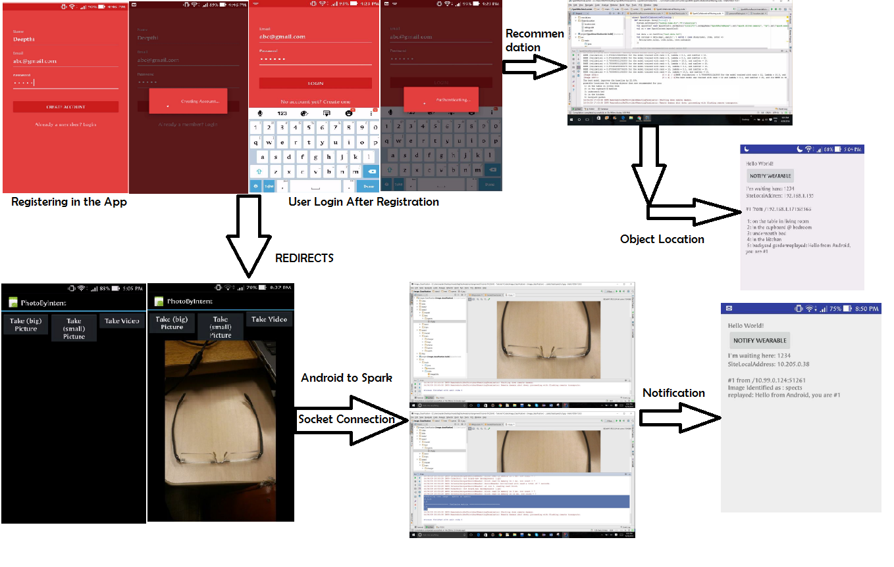
Flow Screenshots

Slide 5
Advantages
With this Application the user could be able to locate his lost objects in his house
The user need not stress himself in memorizing the location of the most important objects that he uses frequently
Time saving

Slide 6
Thank You

